Slide 1




The Italian Securities and Markets Authority
Recent initiatives on investor education in Italy
Global Symposium
Implementing effective financial literacy policies
in a changing financial landscape
Session 2.2: Supporting safe investment through financial education
NEW DELHI
9 November 2017
Pasquale Munafò
General Manager’s Office at CONSOB
Vice Chair of the IOSCO Committee on Retail Investors (C8)

Slide 2
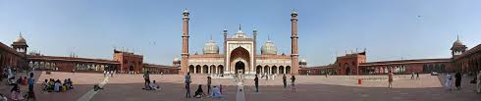
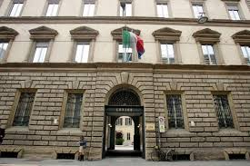
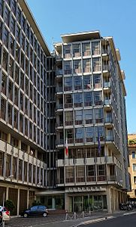





  Consob and its role on investor education
Consob and its role on investor education
The Italian authority responsible for the supervision of the securities sector
Milan headquarters
Rome headquarters
Regulatory
powers
Supervisory
powers
Investor education not a statutory objective per se but complementary tool to its general powers
Sanctioning
powers
Investor education
Protection of investors
New Delhi, 9 November 2017
High-level Global Symposium on Financial Education - Consob and investor education
2

Slide 3

The Italian context
Level of financial knowledge in Italy is below the average of other G20 countries
Lack of knowledge, use of informal information channels, «over-confidence», behavioural biases, low risk tolerance
Low ability to manage budget planning properly, especially in a long-term perspective
Risk of financial vulnerability due to economic decisions which are inconsistent, incorrect and unconnected
Big (policy) challenge in Italy: (still) high saving rate vs. high risk aversion

Slide 4
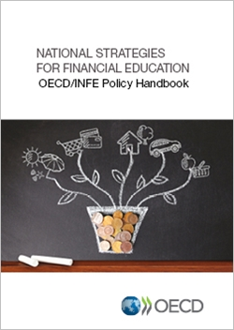
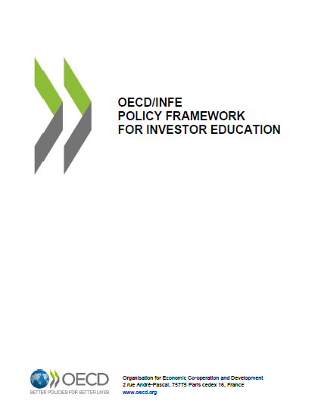

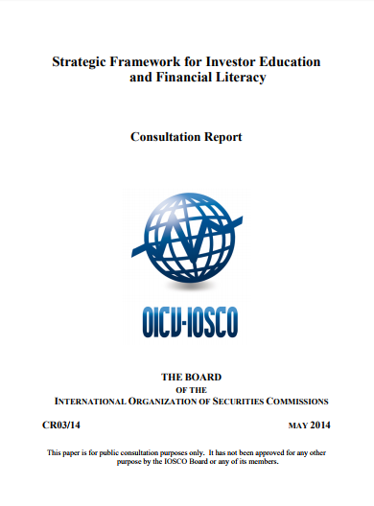

Main references and key messages
«Need for a national strategy for financial education and a related infrastructure»
«Accurate consideration to context and financial industry structure»
«Investor education as an integral part of financial education»
«Need for monitoring and evaluating the implementation of IE initiatives»
«Development of competencies for targeted people»
«Identification of the best ways of delivering investor education»

Slide 5


Consob activities on investor education
A yearly (a) publication on financial investments of Italian households and (b) plan on investor education activities (under the remit of the Deputy General Manager)
A dedicated web portal since May 2015 (with focus on tools, behavioural features and financial planning)
Some specific, targeted projects on investor education [in collaboration with consumer associations, Universities, etc.]
e.g. Charter of Investors 2014, “Settimana Mondiale dell’Investitore 2017” (IOSCO World Investor Week)
Regular cooperation with other Authorities (draft of guidelines on National Strategy on Financial Education)
National Committee on Financial Education (established in July 2017)

Slide 6
National Committee on Financial Education
Prof. Annamaria Lusardi (Director) + 10 Members (experts on the topic)
Committee for the planning and coordination of financial education activities
Four Ministries (of Economy and Finance, of Education, Universities and Research, of Economic Development, and of Labor) + four Authorities (Bank of Italy, Consob, Covip and IVASS) + consumer associations + financial advisors body
First meeting in September 2017, afterwards about one every month to date
Design and implementation of the national strategy for financial, insurance and pensions education
Financial education not seen as a response to the crisis, rather as a necessity in a changing, more complex world
Draw on other 65 countries which have already or are about to put in place national strategies
It is for the well-being of everybody

Slide 7

Some first insights and points under discussion
Mapping of education activities and creation of a permanent database on financial education activities
Long term view, with some initiatives in the short term (e.g. a national web portal on financial education)
Drafting of the national strategy on financial education as the enabling framework
Youth and (targeted) adults as natural recipients
Emphasis on content i.e. educational material and «learning by playing» tools
Launch of a communication campaign (e.g. TV ads and programs)
Need for monitoring and evaluation

Slide 8
The Italian Securities and Markets Authority
Thank you!
Pasquale Munafò
General Manager’s Office at CONSOB
Vice Chair of the IOSCO Committee on Retail Investors (C8)

