Slide 1
Financial Literacy for older generations in the digital age November 9, 2017
Sandra Boyd-Hoare

Slide 2
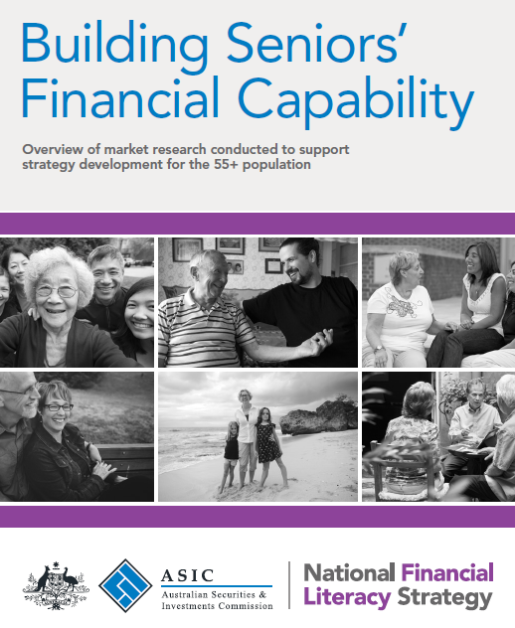
Exploring the Australian Seniors’ population
Qualitative (focus groups)
Quantitative (segmentation)
Depth interviews: vulnerable
Focus groups: Seniors’ supporters
ASIC Report 537

Slide 3
Seniors – Considerable diversity
Segmentation variables:
Current financial situation
Attitudes and confidence
Choice Limited
Today Focused
Reactive Risk taker
Cautious Investor
Savvy Investor
Choice Rich
41%
22%
37%
Cognitive or physical decline don’t discriminate
37%

Slide 4
Digital age – Need for tailored approaches
Choice Limited
Today Focused
Reactive Risk taker
Cautious Investor
Savvy Investor
Choice Rich
Robo Advice
Attraction of lower advice fees
Looking for quick solutions?
Query: ability to account for changing circumstances
Awareness of advice limitations?
80% - professional advice
Confident searching online
SEO - ASIC’s MoneySmart performing well
Website content focus
May use robo-advice for specific issues
Even online bill payment a challenge
Preference for face-to-face and ‘advice’ from those they know and trust – leverage this
May take guidance from children
37%

Slide 5
Digital age – Need for tailored approaches
Choice Limited
Today Focused
Reactive Risk taker
Cautious Investor
Savvy Investor
Choice Rich
Phishing; Online scams; cyber security
Vulnerable to ‘get rich quick’ schemes
Challenge: awareness of our messages
Reinforcement
Naturally cautious
Communication strategy crucial
Networks (e.g. women’s)
Aware and well read;
Less vulnerable
Own networks alert
Reinforcement assists
Focus on the support networks they tap into
Community organisations
Close alignment with other government agencies
37%

Slide 6



Importance of Seniors’ Supporters
Choice Limited
Choice Rich
Triggers for engagement:
Declining physical or cognitive health
Loss of partner and new responsibilities
Digital environment / loss of confidence

Slide 7
Focus for ASIC’s Financial Capability team
Development and curation of targeted information, tools and resources tailored to:
Specific segment needs
Seniors’ supporters
Intermediaries and other government agencies who work closely with particular segments
Tailored promotion and distribution strategies
Channels (traditional and new); stakeholders

