Slide 1
Financial education in the workplace
RBI-OECD High Level Global Symposium on Financial Education November 9, 2017
Presented by : Jérémie Ryan

Slide 2


The National Strategy for Financial Literacy and the workplace initiative
The National strategy for financial literacy sets out goals and priorities to help Canadians better manage their finances and make appropriate decisions as their needs and circumstances change.
The Government of Canada has made helping Canadian families and growing the middle class a priority as a way of building strong communities across Canada and strengthening the economy.
Leveraging the workplace is an effective channel to reach the widest audience of Canadian adults, with the broadest range of economic circumstances.
Notes:
The public consultations in support of the development of the National Strategy for Financial Literacy – Count me in, Canada held in 2014 by FCAC revealed that the most effective way to reach Canadians with financial literacy tools and training is ‘where they are at’ and ‘where they spend time’.
Based on this, workplaces represent one of the most effective venues for delivering financial literacy to adults.
Multiple studies, surveys and research including those undertaken by the Financial Planning Standards Council and Manulife/Ipsos Reid, show that :
Money problems are cited as the greatest source of stress for Canadian workers.
Financial stress affects health and workplace performance.
More workplaces offering financial literacy will lead to more Canadians learning to manage money and debt wisely and planning and saving for the future.
There is an opportunity to develop and/or expand on existing programs to support Canadian workers in developing the skills they need to manage their money both in the short term (budget, saving, debt) and over the long term (saving for retirement) in ways that will be engaging to them.

Slide 3
Money is a leading cause of stress
Many Canadians are distracted at work because of financial stress
42% rank money as their greatest source of stress.
47% are living paycheque to paycheque.
35% feel overwhelmed by debt.
67% have admitted to dealing with financial issues at work.

Slide 4
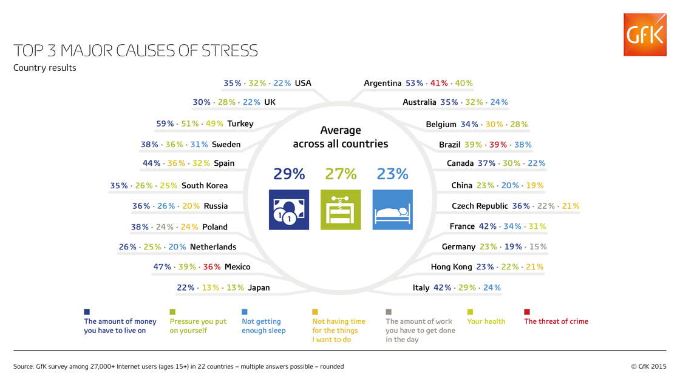
Money is a leading cause of stress. Reasons for financial stress

Slide 5
  FCAC’s workplace initiative
  Objective: To help working Canadians:
Budget and manage money and debt
Save and plan
for the future
Know rights and
responsibilities
Notes:
The Government of Canada has made helping Canadian families and growing the middle class a priority as a way of building strong communities across Canada and strengthening the economy.
Leveraging the workplace is an effective channel to reach the widest audience of Canadians adults, with the broadest range of economic circumstances.
The purpose of FCAC’s workplace initiative is to strengthen the knowledge, skills and confidence of working Canadians in order for them to build a better financial future
The objective of the workplace initiative is to help working Canadians:
Budget and manage money and debt wisely;
Save and plan for the future;
Ensure they know their rights and responsibilities pertaining to financial products and services

Slide 6
Workplace Initiative - Activity Plan
Research
Communications
Outreach
Short informal online survey
Environmental scan on available research in support of workplace initiative
Tools & Resources
Workplace employer mail out via Canada Post
Web page
Workplace poster
Workplace financial literacy promotion and awareness strategy
Evaluation
Working group - workplace financial literacy
FLL outreach strategy for workplace
National Conference on financial literacy 2017
FLM 2017
Other federal departments engagement strategy
Financial Health Challenge aimed at workplace
Best practices framework
Canadian Financial Literacy Database – new functionality
Workplace financial literacy pilots
Evaluation of pilots project
Evaluation of best practices
Notes:
At the beginning of this initiative, we developed the strategy with five key categories of activities to lay out the strategy
Research;
Communications;
Outreach;
Tools and Resources; and
Evaluation

Slide 7
Working group deliverables:
Develop a Best Practices Framework for financial literacy in the Workplace and disseminate to employers across Canada;
Deliver workplace financial literacy programs/initiatives.
Undertake pilot projects, evaluate and report on findings;
Additional deliverables may be established in alignment with the goals of the National strategy for financial literacy.
Notes:
As part of the FCAC’s workplace initiative, FCAC has formed a Working group on financial literacy in the workplace , reporting to the NSC, to develop and expand on Workplace Financial Literacy in order to support Canadian workers in developing the skills they need to manage their money both in the short term (credit, saving, debt) and over the long term (saving for retirement) and to help them understand their rights and responsibilities pertaining to financial products and services in ways that will be engaging to them.
The working group is composed of 11 participants from strategically selected associations.
The Working group's main deliverable is to develop a Best Practices Framework, a robust blueprint for employers to use when offering workplace financial literacy initiatives/education, supported by tools and resources, turn key solutions for Canadian employers of all sizes in providing financial education in their organizations.

Slide 8
Best practices framework for financial literacy in the workplace
Research-Based
Evidence-Based
Pilots
Notes:
The Best Practices Framework will be developed using a holistic approach. It will be built on three components:
Research-based - This component is the review of research and research findings to identify what is known, and what can be applied as best practices when delivering financial literacy in the workplace.
Evidence-based- This component will be based on the following:
Experience of Working group participants in delivering workplace financial education.
Best practices
Lessons learned
Pilots conducted by FCAC- currently in the planning phase of the pilots and looking at modifying the content from Your Financial toolkit into a lunch and learn format. The pilots and the evaluation results of the pilots will allow us identify key findings from FCAC’s own experience-based learnings. These key findings will assist in building the best practices framework.

Slide 9

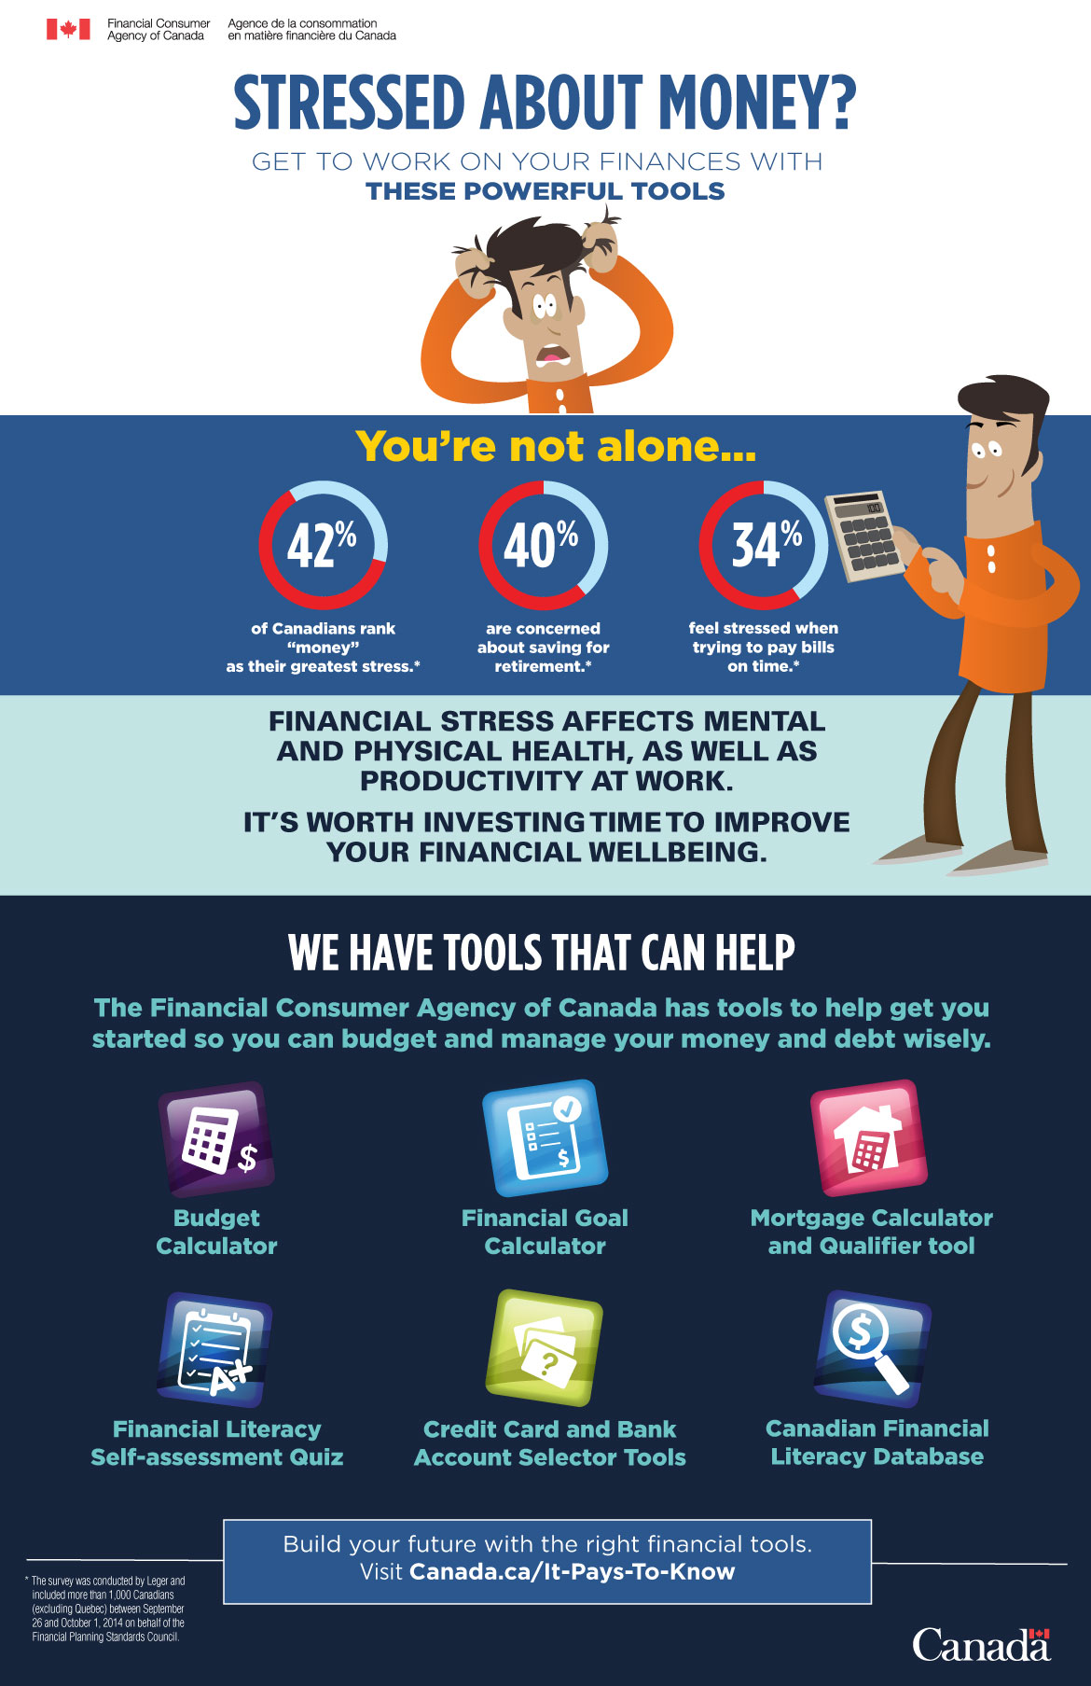

Slide 10




Innovative Digital Initiatives
Small change app
Carrot app
Notes:
Research shows financial stress is the number one stressor for most Canadians. Employers that offer financial education are directly helping their employees address this stress head on, often resulting in improved morale and productivity.
In this session, members of FCAC’s Workplace Working Group will share their research, knowledge and best practices when engaging organizations about the importance of workplace financial literacy in Canada. This panel also features an international panelist (Laura Higgins) who will present her experience of bringing financial education to teachers in Australia.

Slide 11
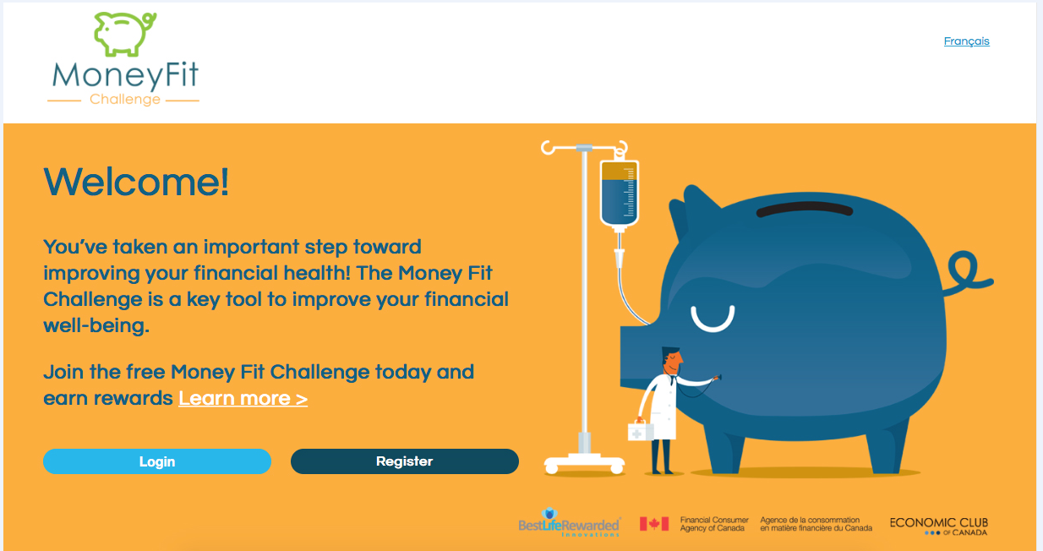
Money Fit Challenge: A Financial Health Challenge
Notes:
Project with Best Life Rewarded Innovations – Financial Health at Work Challenge
We are currently exploring a behavioural nudging approach in collaboration with Best Life Rewarded Innovations and Economic Club of Canada.
In the last 4 years, BLRI has run a Mental Health in the workplace challenge. BLR’s current challenge model has been quite successful and has over 120 participating organizations. (including Canadian Diabetes Association, Canadian Blood Services, Mercer, Workplace Safety and Insurance Board
and government departments such as DND - ADM(Fin), Environment Canada, etc. take part.
We would be leveraging the existing platform and creating a Financial Health at work Challenge targeted to workplace that we hope to launch for 2017 FLM.
the way it works in general is that participants in the challenge earn points for completing activities. In addition, the organization’s contact point earns the team points by administrating the challenge and doing certain activities. All points result in ballots for prize draw. The objective would be to strengthen the knowledge, skills and confidence of Canadians resulting in improved financial well-being.

Slide 12
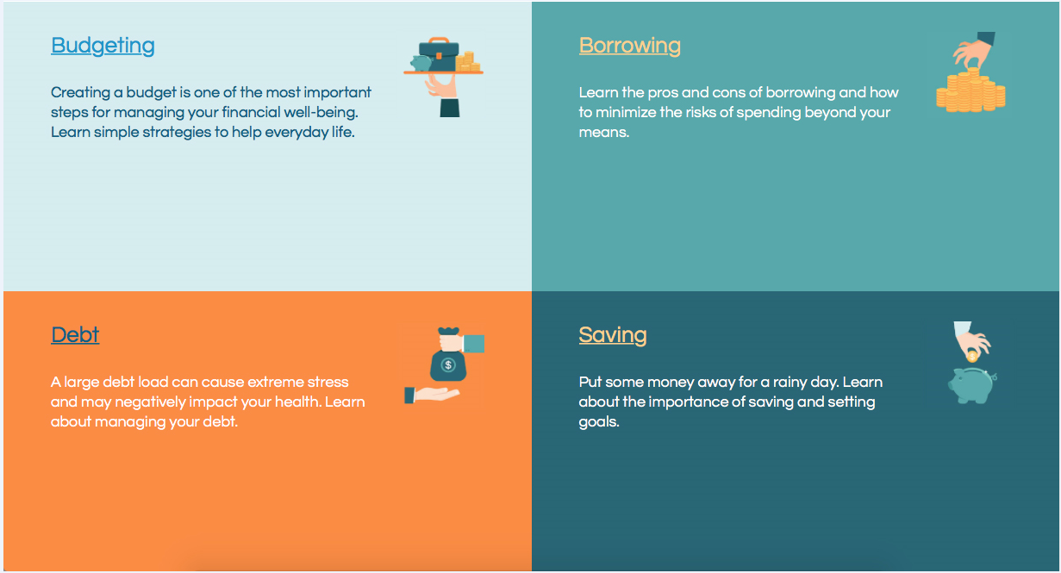
Money Fit Challenge: A Financial Health Challenge
Notes:
The challenge leverages our content, videos and tools. These are 4 quadrants focusing on
The objective of the workplace initiative is to help working Canadians:
Budget and manage money and debt wisely;
Save and plan for the future;
Ensure they know their rights and responsibilities pertaining to financial products and services

