Slide 1
Insights from Financial Literacy Surveys and Their Implications on Policy and Practice 8 November 2017
Johnny Noe E. Ravalo Ph.D.
Assistant Governor
Office of Systemic Risk Management
Bangko Sentral ng PIlipinas

Slide 2
FinLit is Important
While there are many causes to the economic problems facing the country, it is undeniable that a lack of financial literacy is a contributing factor.
Charles R. Schwab, January 2009

Slide 3
FinLit is Important for Achieving Financial Stability
While there are many causes to the economic problems facing the country, it is undeniable that a lack of financial literacy is a contributing factor.
Charles R. Schwab, January 2009
But the lack of understanding of households on financial issues and, in particular, on credit and investment, has also a major role. As a result individuals have accepted (sometimes unknowingly) to support more financial risks than what they could afford.
Financial Education and the Crisis
OECD/INFE June 2009

Slide 4
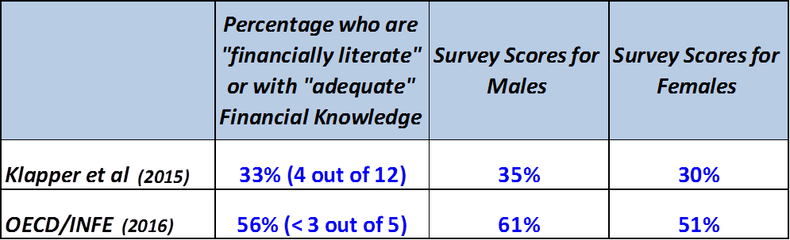
The Numbers Differ … But the Message is the Same
Survey scores are alarmingly low
There is a “gender gap”

Slide 5
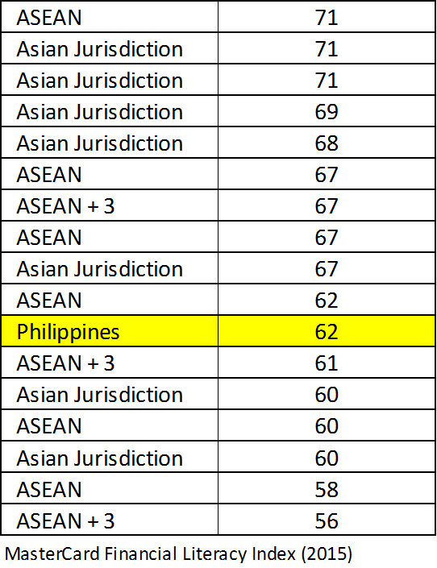
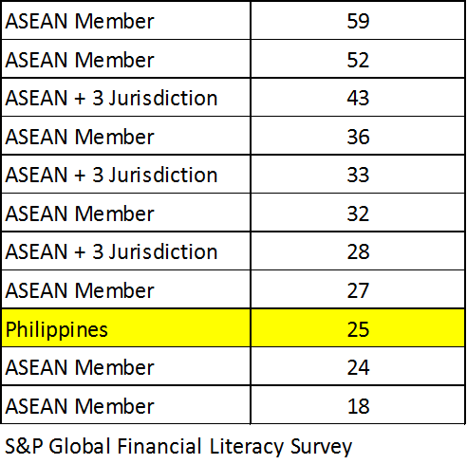
We Often Revert to Ordinal Rankings … but
There will be fundamental differences across countries
For example, in the Philippines, women do better on FinLit surveys than men

Slide 6
Perhaps the Messaging Should Be More Focused
Profile of those who do well in finlit surveys
Those who self-assess themselves to be financially literate
With highest educational attainment
With highest income
Regularly use traditional and/or social media
Live in the inner city
Started saving as a child
Head of household
Demographics certainly matters but what is the policy intervention?
Will expanding financial education programs be the main policy objective?

Slide 7
There Might Be Confusion that the Gains Are Private
Profile of those who do well in finlit surveys
Those who self-assess themselves to be financially literate
With highest educational attainment
With highest income
Regularly use traditional and/or social media
Live in the inner city
Started saving as a child
Head of household
Financial Education
financial literacy:
awareness, knowledge, skills, attitude, behaviors
financial decisions that improve financial well-being

Slide 8
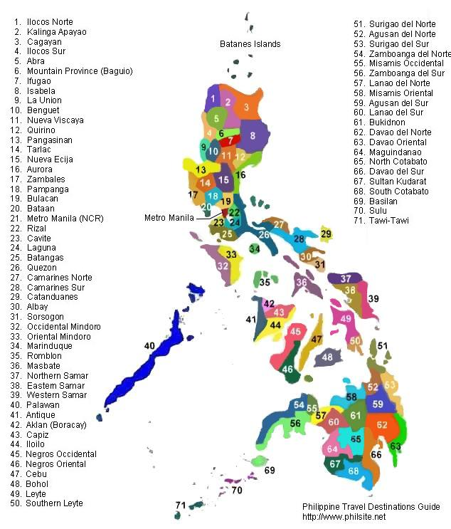
Our Thinking is that Financial Education …
Financial Education
financial literacy:
awareness, knowledge, skills, attitude, behaviors
financial decisions that improves financial well-being
managing financial risks in the context of financial stability

Slide 9
Our Thinking is that Financial Education …
National Strategy for FE
Key messages:
Save for retirement
Save for uncertainty
Avoid over indebtedness
Mitigate fraud
Execute at provincial level

Slide 10
Our Thinking is that Financial Education …
National Strategy for FE
Pursuit of financial stability
Key messages:
Save for retirement
Save for uncertainty
Avoid over indebtedness
Mitigate fraud
Execute at provincial level

Slide 11
Insights from Financial Literacy Surveys and Their Implications on Policy and Practice 8 November 2017
Johnny Noe E. Ravalo Ph.D.
Assistant Governor
Office of Systemic Risk Management
Bangko Sentral ng PIlipinas

